Slide 2






Cloud Security – Resource Policies and Permissions
Defines
Who as access
What actions can be performed
Read vs. modifications
Notes:
Fault tolerance is the property that enables a system to continue operating properly in the event of the failure of some of its components

Slide 3
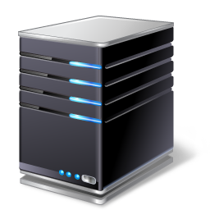
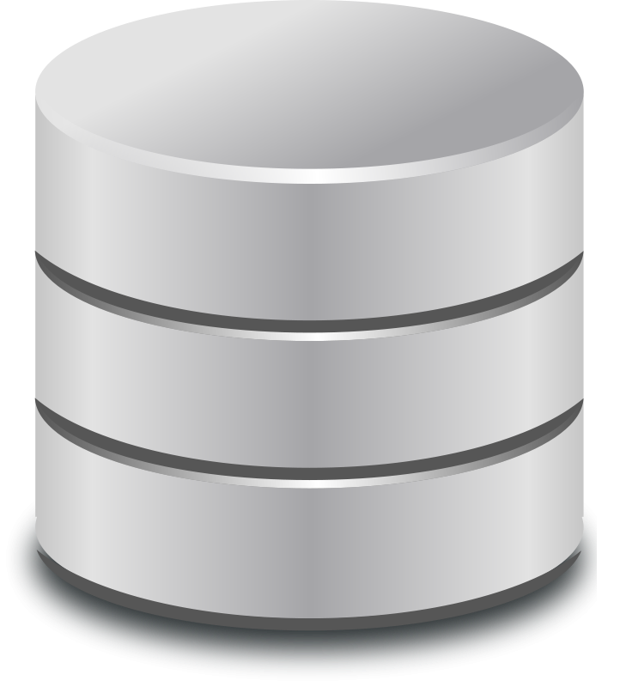
Cloud Security – Network Segmentation and Subnets
Virtual Network
Internet
Segmentation
Web Servers
Database Servers
VPC EP
Secure Web Gateway
CASB
Public Subnet
Private Subnet
Notes:
DNS Filtering
URL Filtering
Intrusion prevention system
Virtual networks
Segmentation
Public subnets
Private subnets
VPC Endpoints

Slide 4


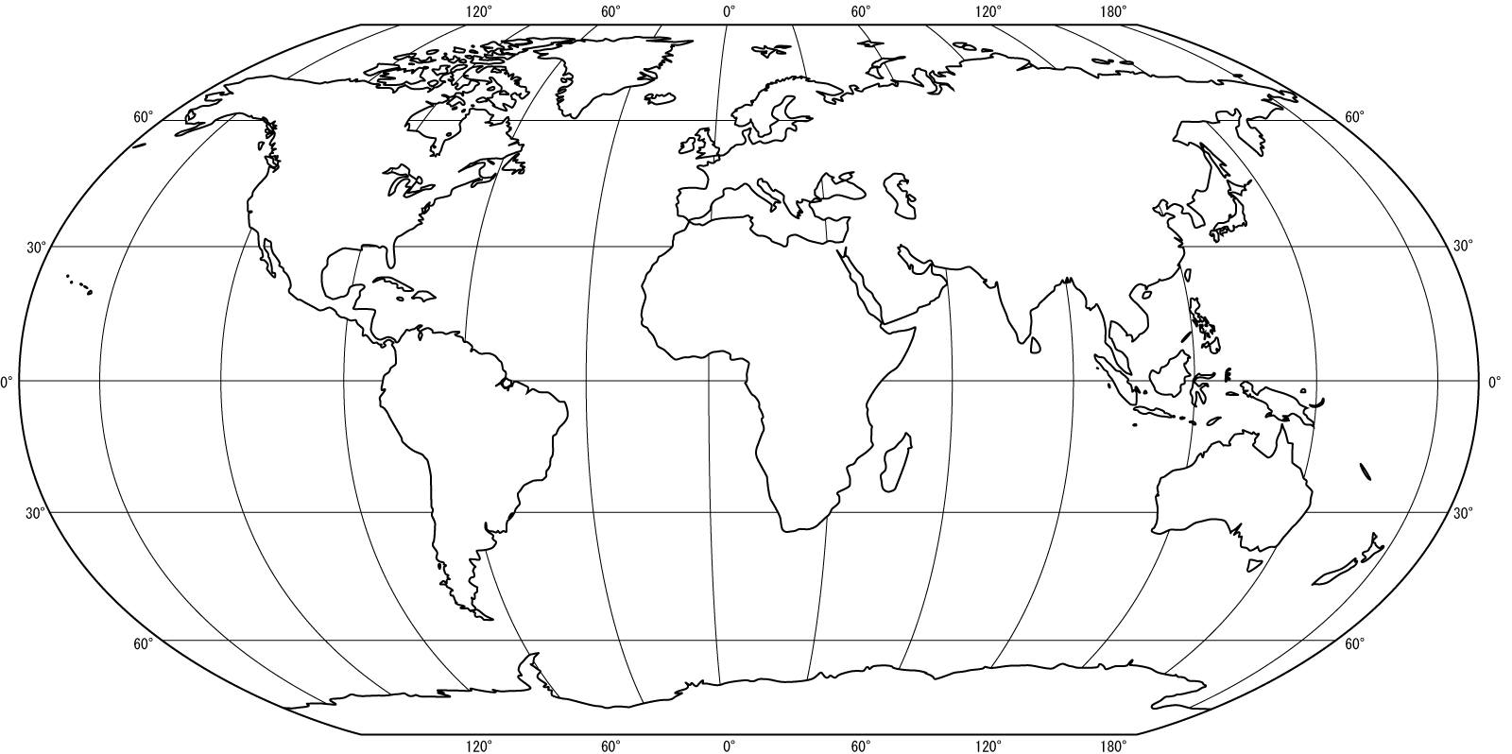
Cloud Security – Storage Considerations

Slide 5
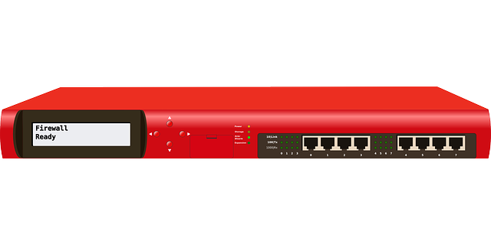
Compute Considerations
Security groups
Virtual firewalls
Port 80
HTTP
Port 443
HTTPS
Notes:
Security Groups allow you to specify allow rules
Security Groups allow you to create rules to filter traffic based on protocols and port numbers

Slide 6
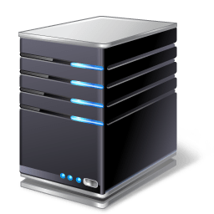

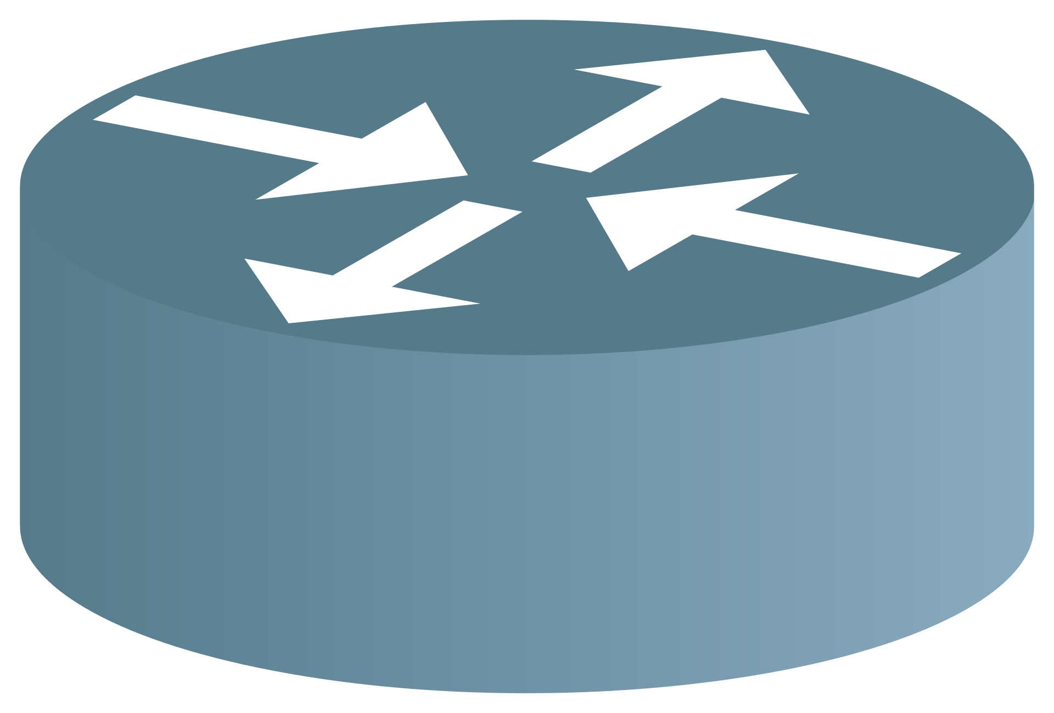

Compute Considerations
Container security
Host
Application
Network traffic
Least privilege
Notes:
Security Groups allow you to specify allow rules
Security Groups allow you to create rules to filter traffic based on protocols and port numbers

Slide 7


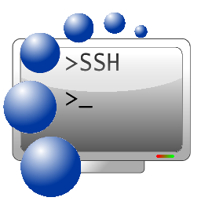
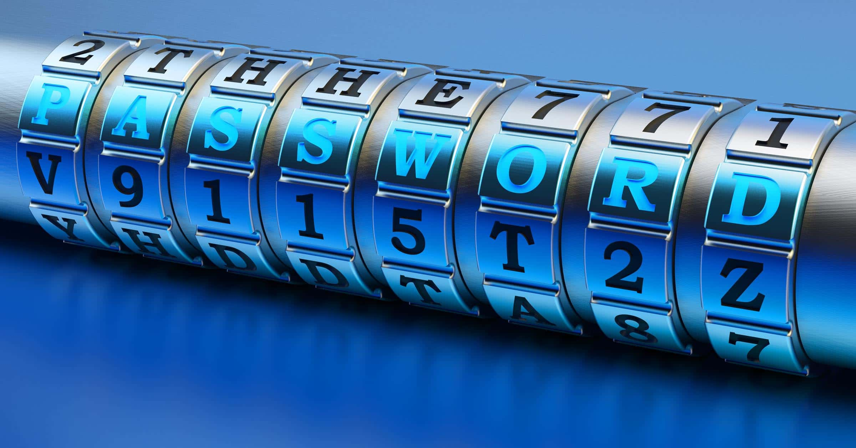
Cloud Security – Secrets Management
Like an HSM
Stores, manages and rotates
API keys
Certificates
SSH keys
Passwords

